Slide 1


Project Name – Liner Regression
Group Members – 1.Akshay.m
2.Sumanth
3.sudarshan

Slide 2
CONTENTS
Introduction
Regression definition
Linear definition
Softwares
Slope and intercept
Example
Application

Slide 3
INTRODUCTION
Analyze the specific relationships between the two or more variables
This project is done to gain the information about one through knowing values of the others

Slide 4
REGRESSION
A statistical measure that attempts to determine the strength of the relationship between one dependent variable (usually denoted by y) and a series of others changing variables (know as independent variable)
Forecast value of a dependent variable (y) from the value of independent variables(x1,x2,x3……)

Slide 5
LINEAR REGRESSION
The simplest mathematical relationship between two variables x and y is linear relationship
In a case and effect relationship, the independent variables is the cause, and the dependent variables is the effect
Least squares linear regression is a method for predicting the values of dependent variables y, based on the value of the independent variables x.

Slide 6
The first order linear model
Y=B0+B1 X+E
Y=dependent variables
X=independent variables
B0=y-intercept
B1=slop of the line
E=error variable

Slide 7
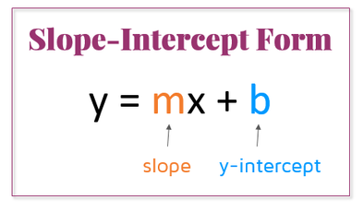
SLOPE AND INTERCEPT
Slope=the slope of line is the change in y for a one unit increases in x
Y-intercept=it is the Hight of the line crosses the vertical axis and is obtaining by setting x=0 in the equation

Slide 8
SOFTWARES
Editor: Notepad ++
Designer: QT design
Language: Python

Slide 9
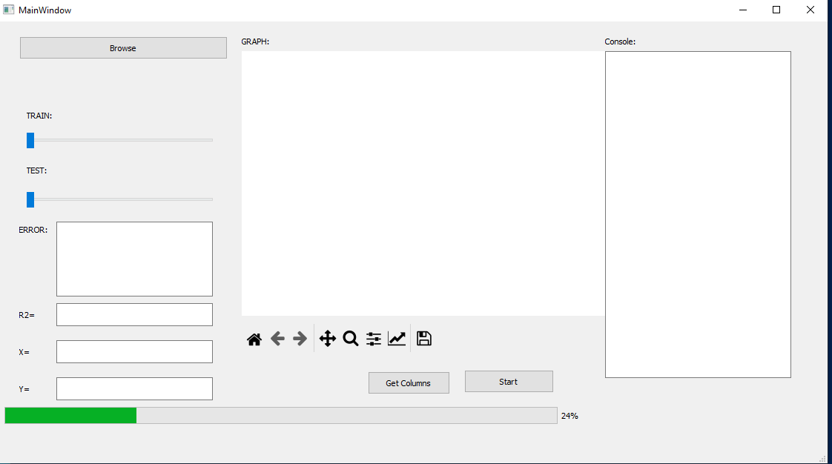
DESIGN

Slide 10
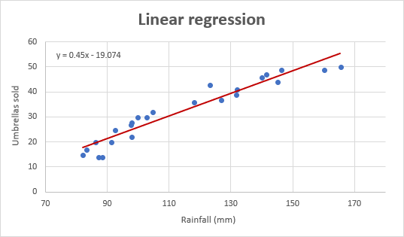
Graph with Data

Slide 11
APPLICATIONS
Trend line
Finance
Economics
Environmental science
Machine learning

Slide 12
THANK Q

